Slide 1
MAHARISHI INTERNATIONAL UNIVERSITY
LIBRARY MANAGEMENT SYSTEM
Course: CS401 Modern Programming Practice (MPP)
Professor: Renuka Mohanraj
Group 3:
Ankhtuya Ochirbat: 610731
Habtom Weldemichael Habte: 610715
Yosief Gobeze:

Slide 2
OUTLINE
Overview
Use case diagram
Class diagram
Sequence diagram
Validation Rules of UI Windows
Extra credit use cases
Conclusion with SCI Knowledge
User Interfaces

Slide 3
Overview
The system maintains the books, members and checkout records by library employees (Librarian and Administrator).
Librarian checks out books for library members.
Administrator creates new library members, edits library member information, adds new books to the collection, and add a copy of existing book to the library.
Super user prints the checkout record of the library member to console and determines a given book copy is overdue.

Slide 4
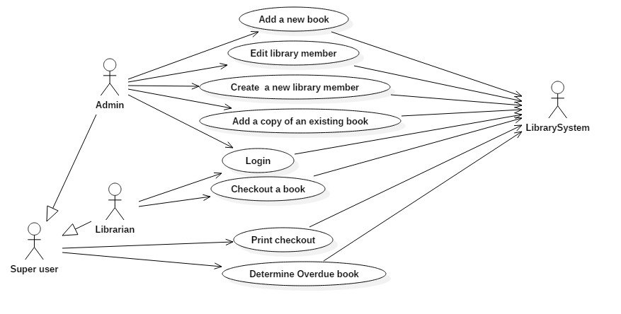
Use case diagram

Slide 5
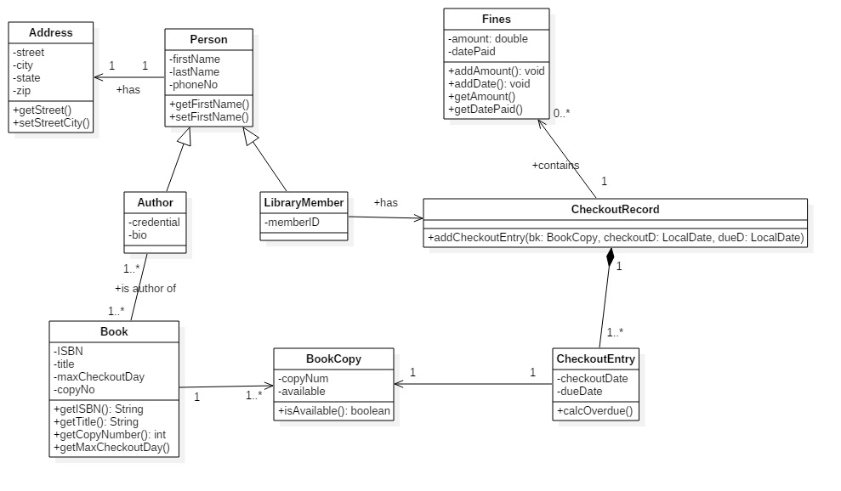
Class diagram

Slide 6
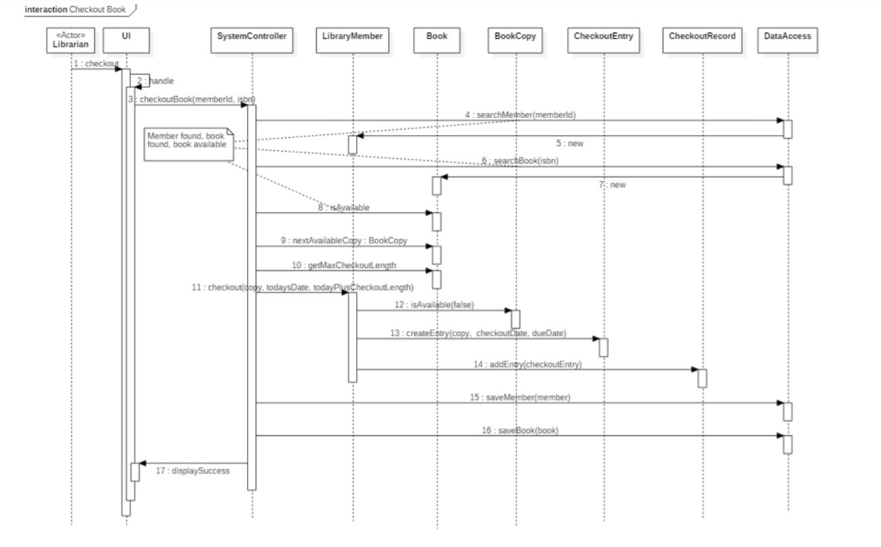
Sequence diagram
Notes:
Checkout a book sequence diagram

Slide 7
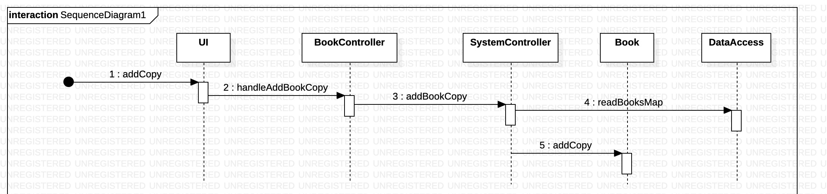
Sequence diagram
Add a copy of an existing book to the library collection

Slide 8
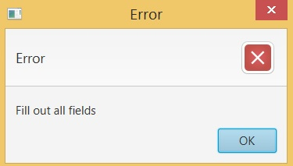
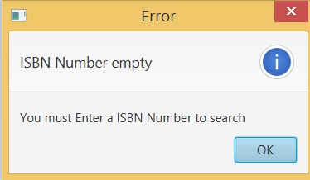
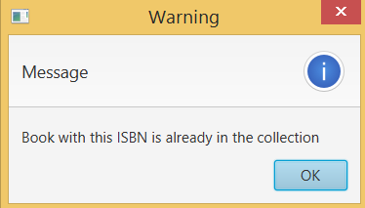
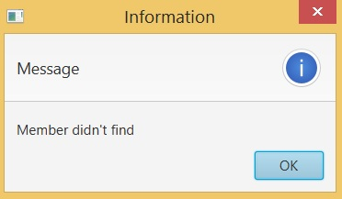
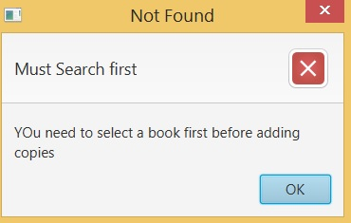
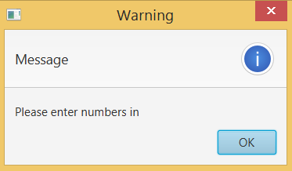
Validation Rules of UI Windows

Slide 9
Extra credit use cases
Print the checkout record of the library member to console
Determine a given book copy is overdue

Slide 10
Conclusion with SCI Knowledge
Knowledge is structured in consciousness: As knowledge is structured in consciousness, the Library management system is constructed from many layers: the UI layer, the business layer, the data access layer, and the utility layer.
The whole is greater than the sum of the parts: All the layers (the UI layer, the business layer, the data access layer, and the utility layer) individually cannot complete the task required. However, the interaction between the different layers yield complete library management task.

Slide 11
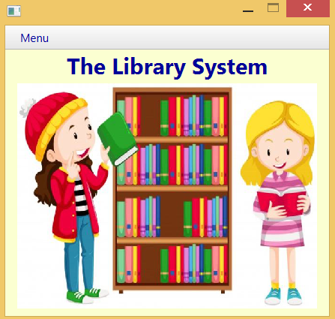
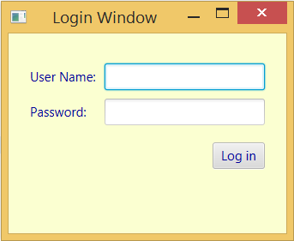
User Interfaces
Main window
Login

Slide 12
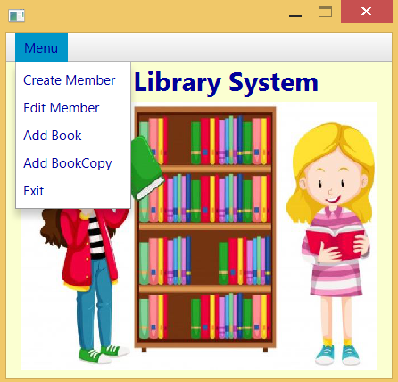
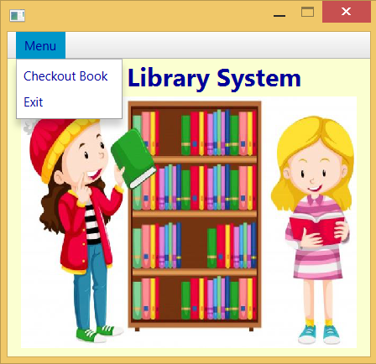
User Interfaces
Admin menu
Librarian menu

Slide 13
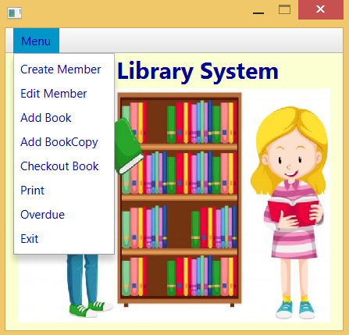
User Interfaces
Super user menu

Slide 14
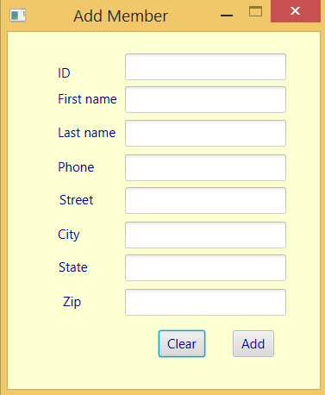
User Interfaces
Add member window

Slide 15
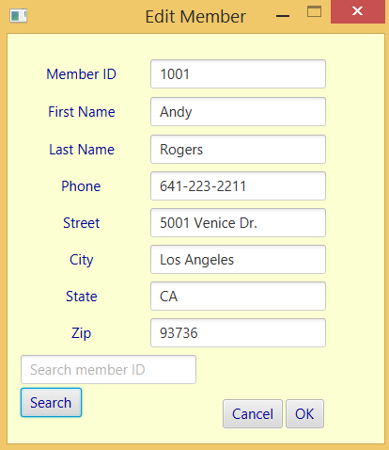
User Interfaces
Edit member info window

Slide 16
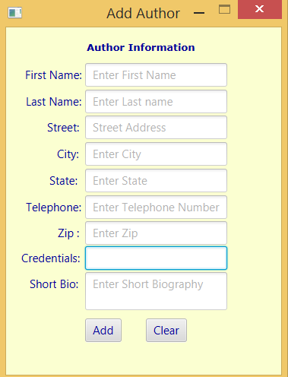
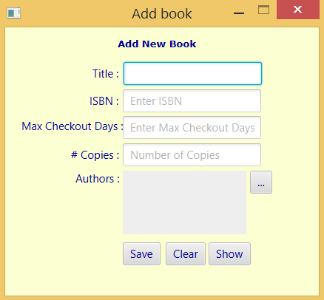
User Interfaces
Add new Author
Add new book

Slide 17
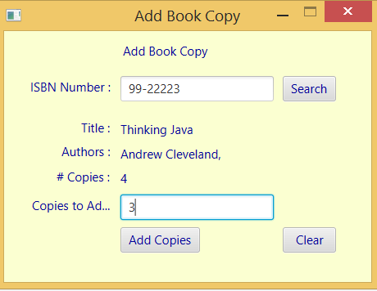
User Interfaces
Add a book copy of existing book

Slide 18
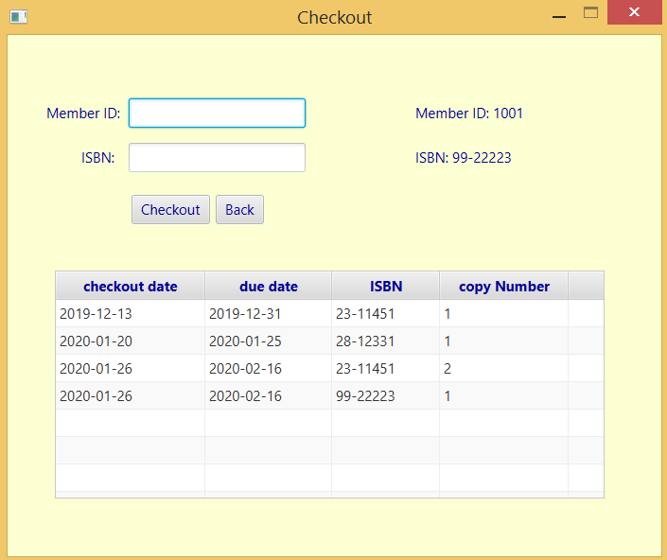
User Interfaces
Checkout book window

Slide 19
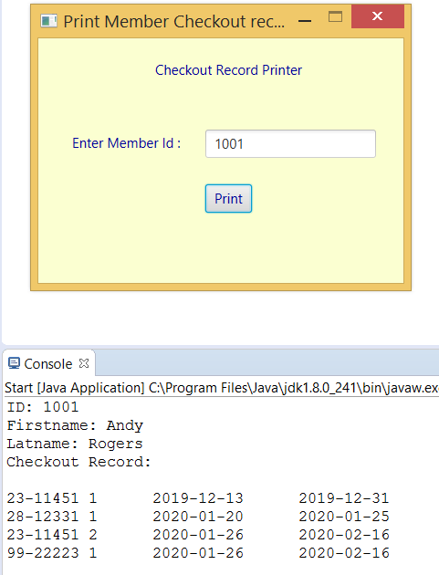
User Interfaces
Print checkout record
of member
Extra credit use case

Slide 20
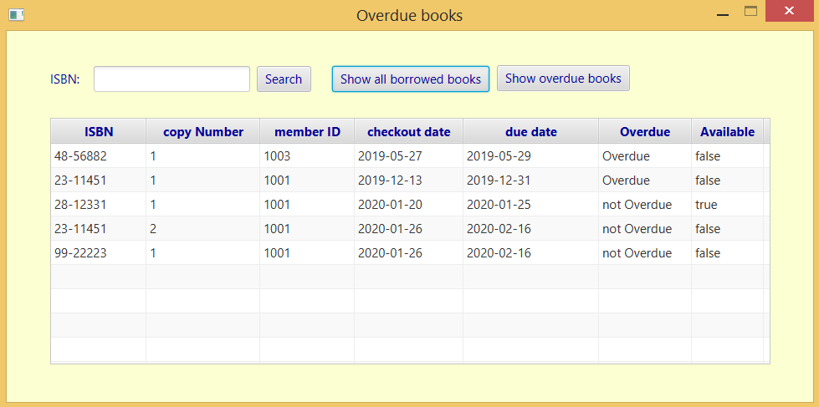
User Interfaces
Determine overdue window
Extra credit use case

Slide 21
Thank you for your attention

